Slide 1
Convergence Study of April Run

Slide 2
Overview
In April run, we did 156 convergence operations. The detailed convergence log can be found in PFS-GEN-IPM004036_Run11_note_rasterlog.pdf.
All diagnostic plots are uploaded to here.
Instead of complete rate, we use the averaged (median) cobra distances to the target locations as the measurement of convergence performance.
We calculate FF RMS offsets relative to their mean position as another measurement.
Factors that impacts the convergence rate:
  Seeing
  Book keeping

Slide 3
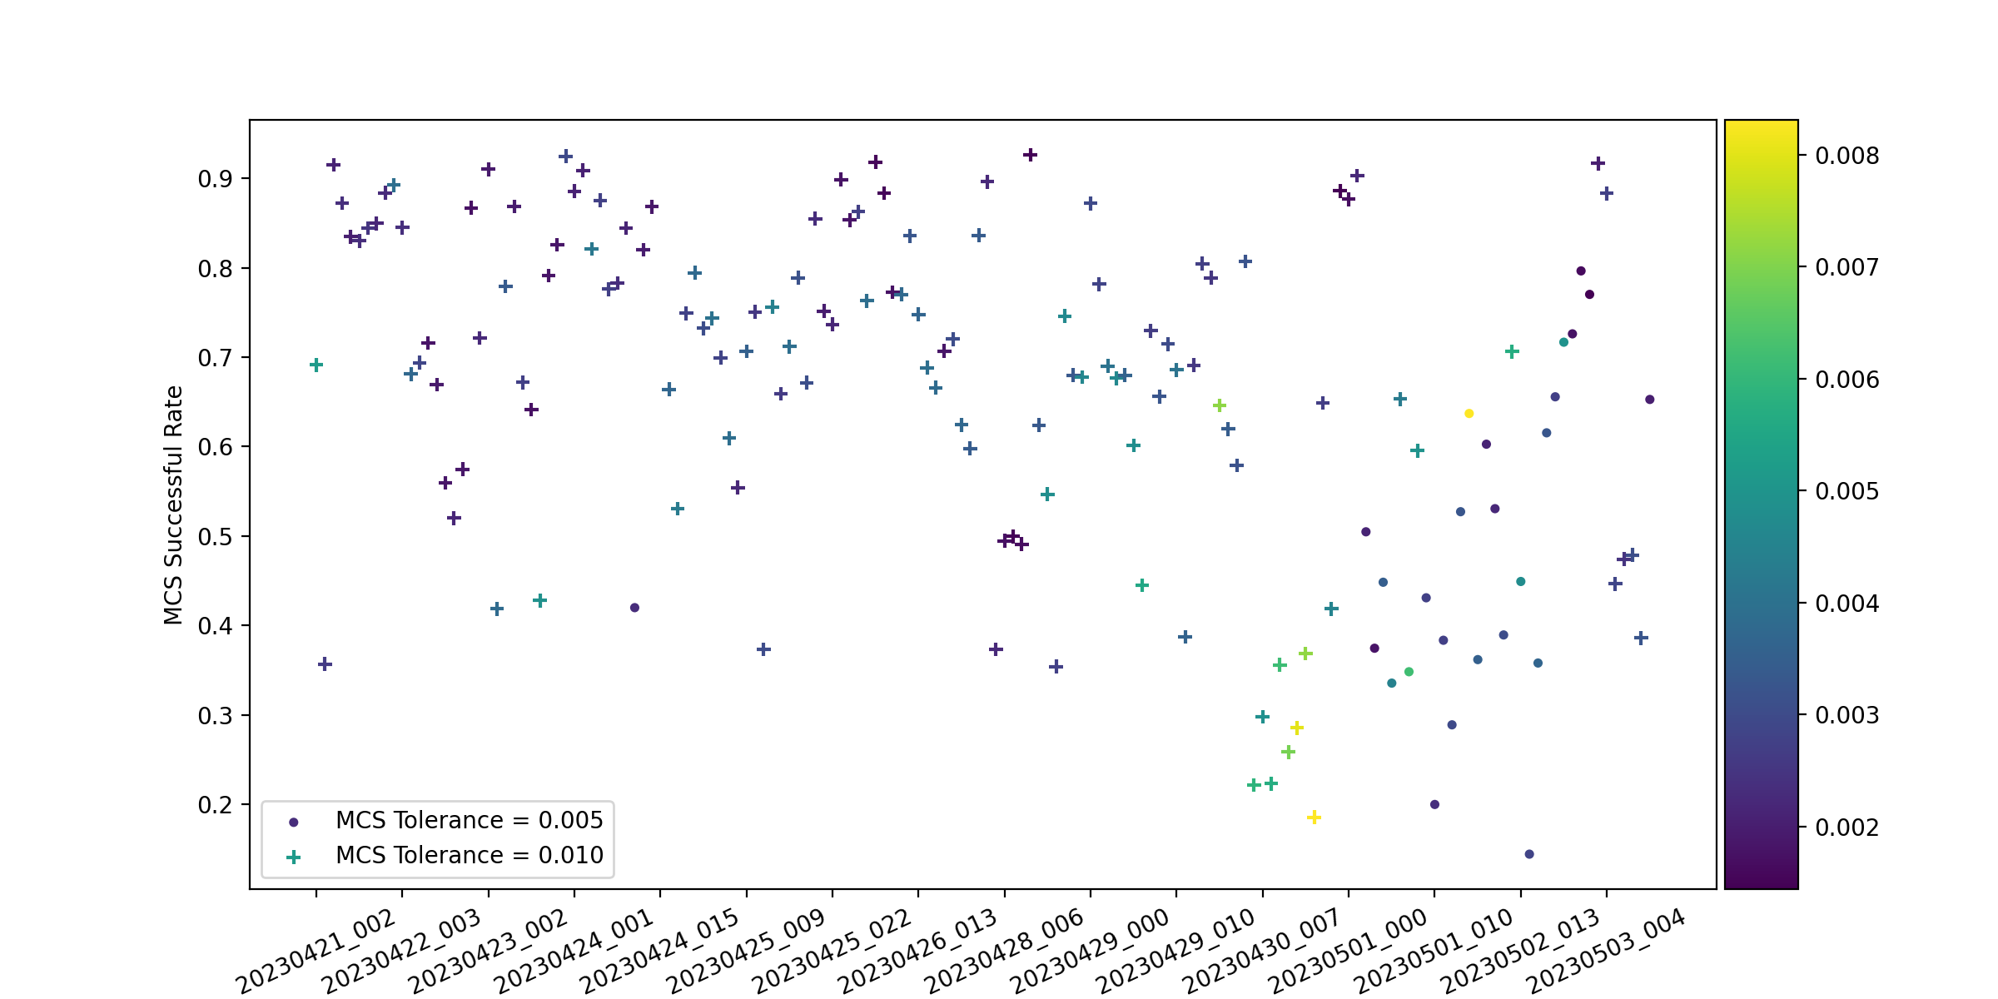
FPS convergence rate may not be a good measurement because it is reported from FPS by accumulating stopped cobras of each iteration.
As we know from last few engineering runs, convergence will be impacted by seeing.

Slide 4
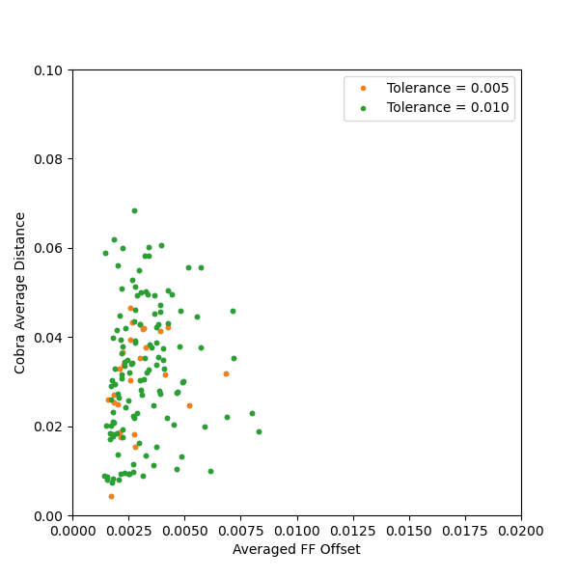
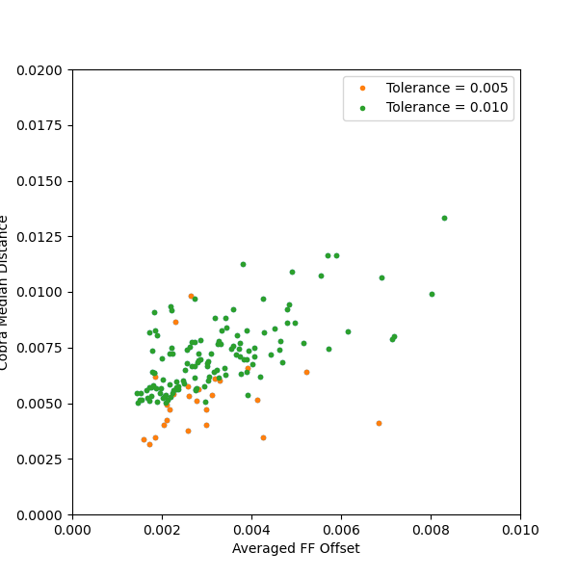
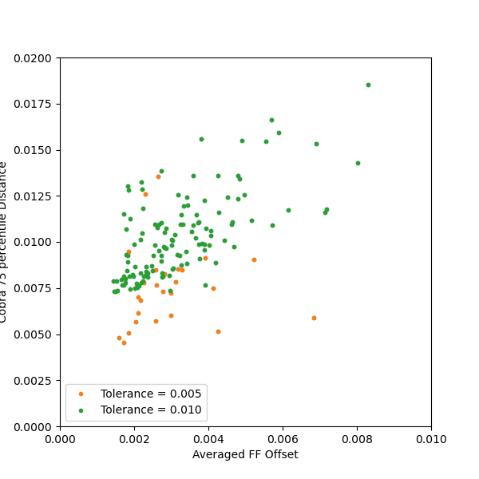
For each FF, we calculate its relative offsets to its mean position at each iteration. By repeating this process on all FFs, we have averaged FF offsets.
We also calculate the averaged (or median) distances between cobra final locations and target positions.
Cobra Mean Distance
Cobra Median Distance
Cobra 75% percentile Distance

Slide 5
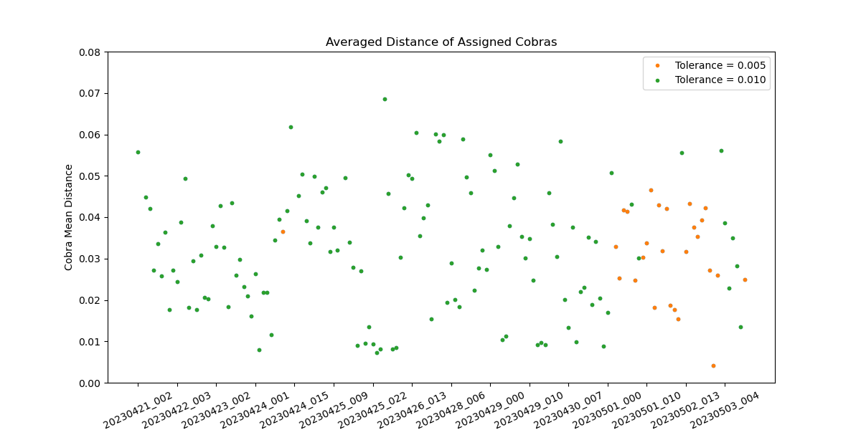

Slide 6
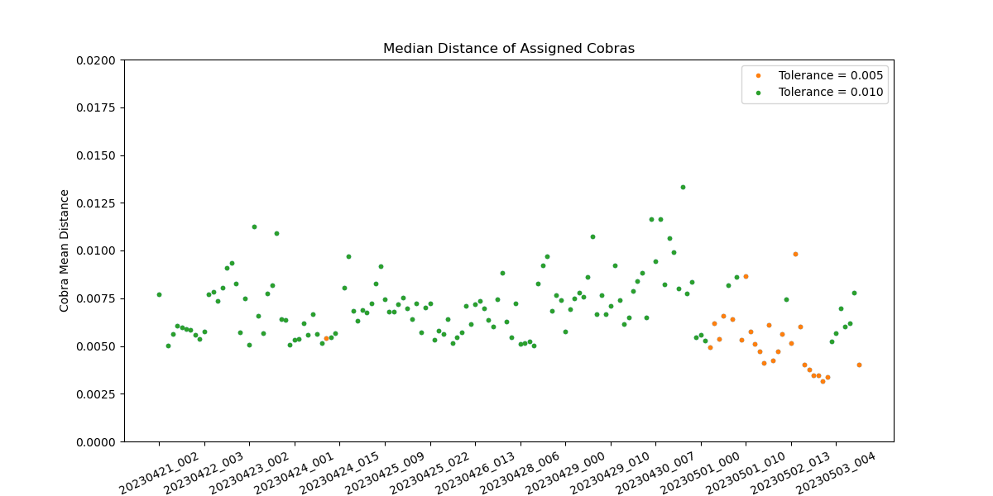
Cobra Median Distance

Slide 7
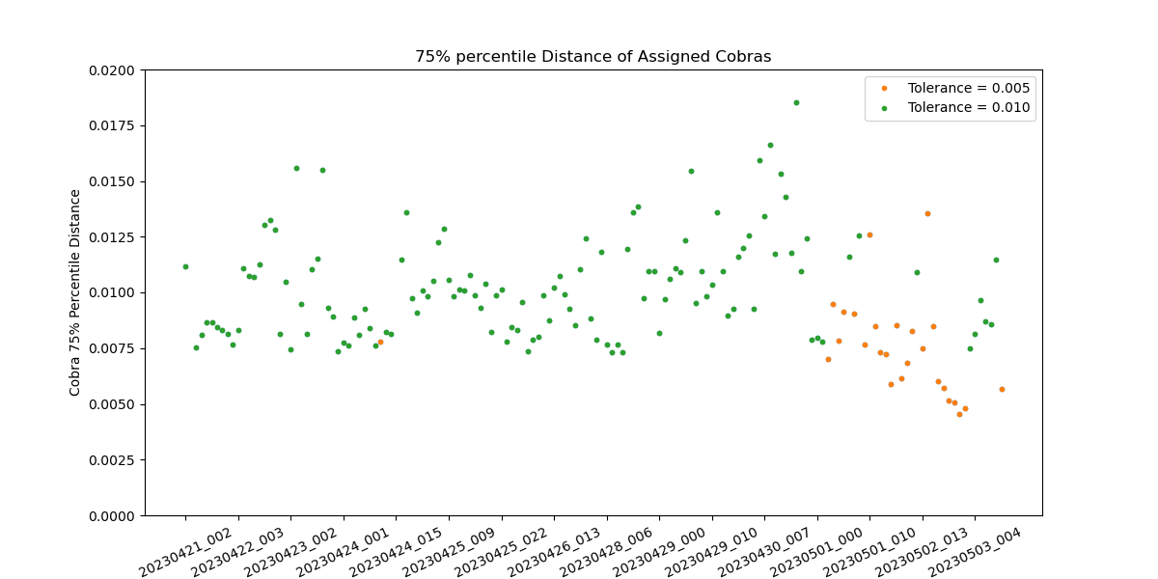

Slide 8
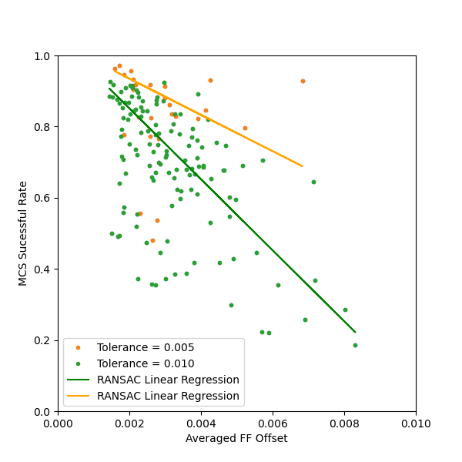

Slide 9
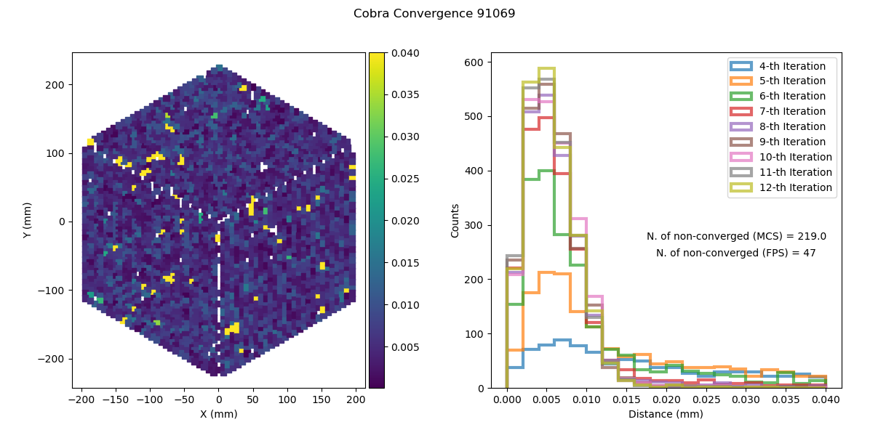
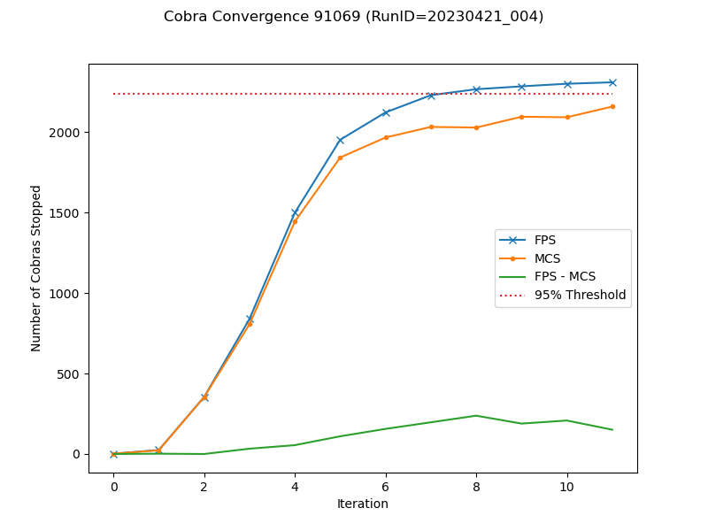
Case of Good Convergence

Slide 10
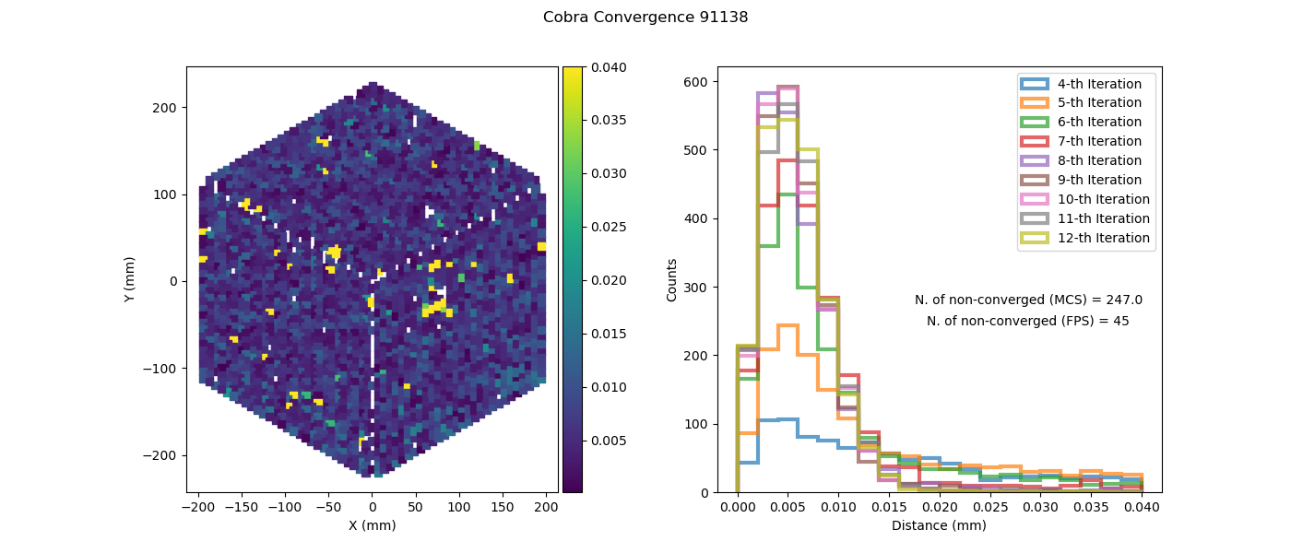
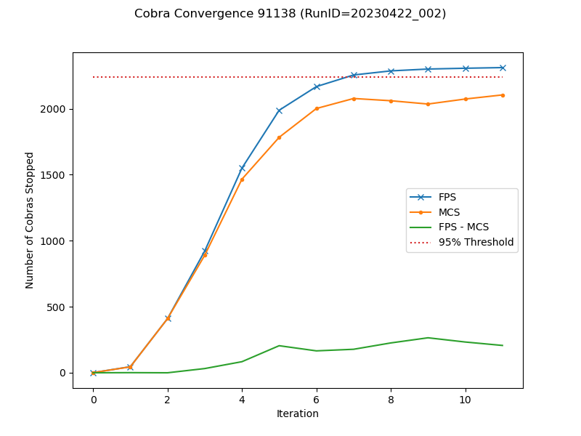
Case of Good Convergence

Slide 11
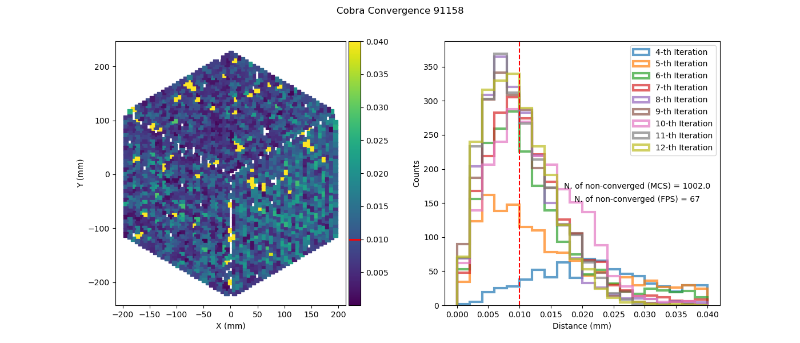
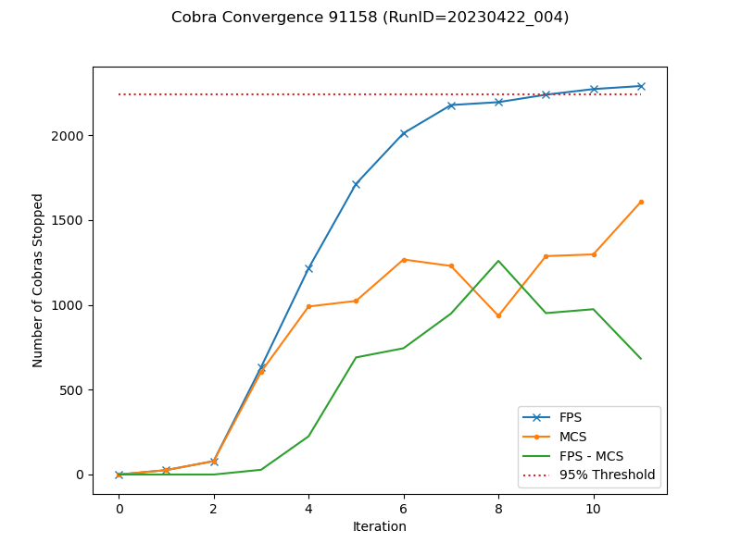
Seeing impact (tolerance =0.01 )

Slide 12
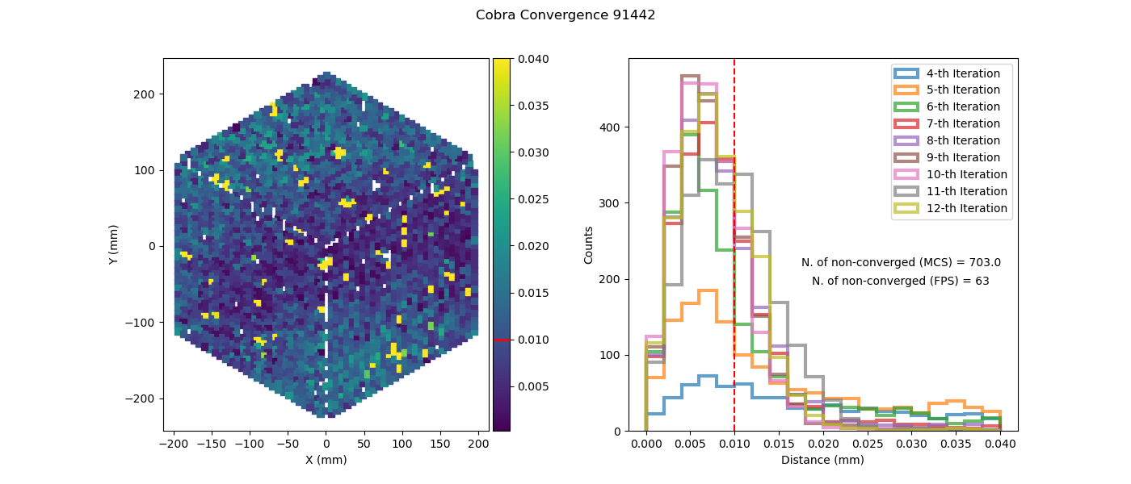
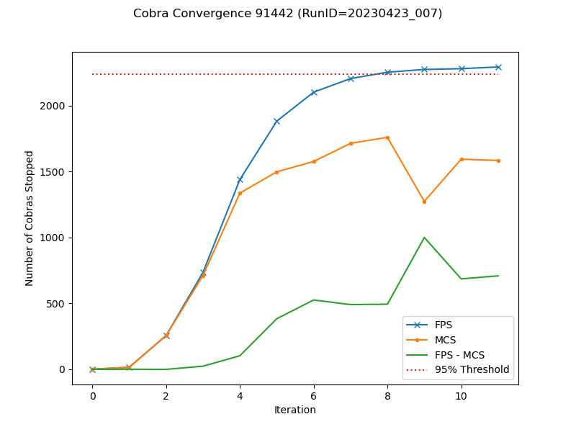
Seeing impact (tolerance =0.01 )

Slide 13
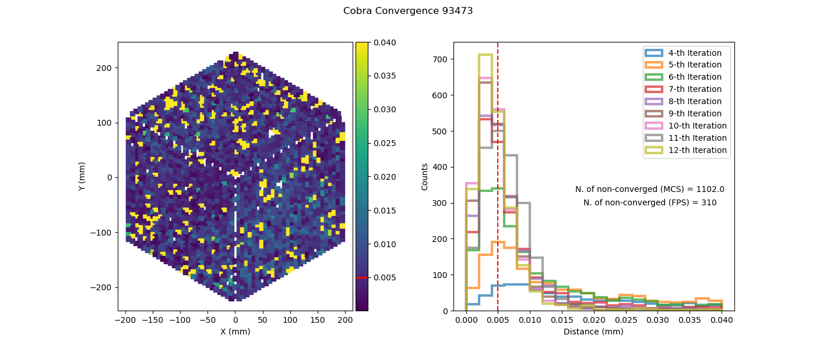
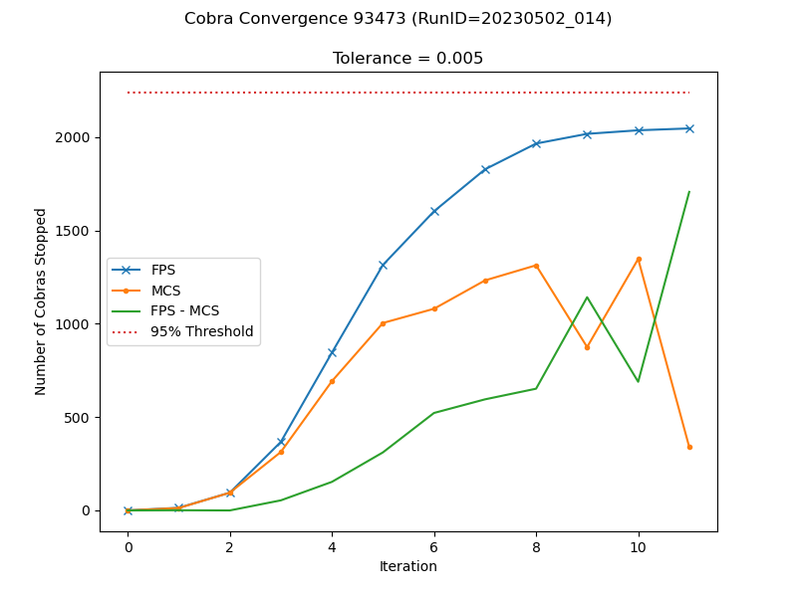
Seeing impact (tolerance =0.005 )

Slide 14
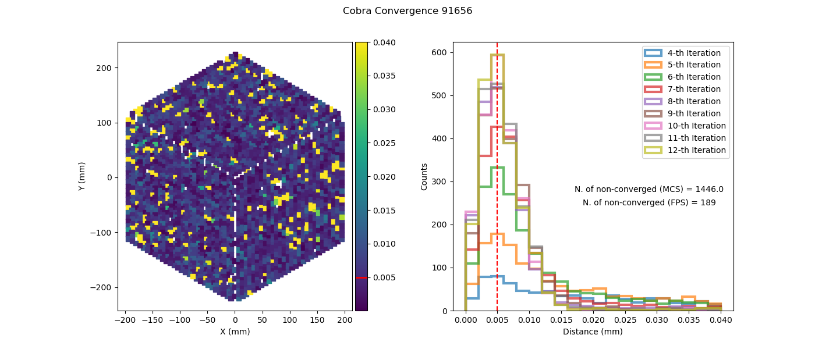

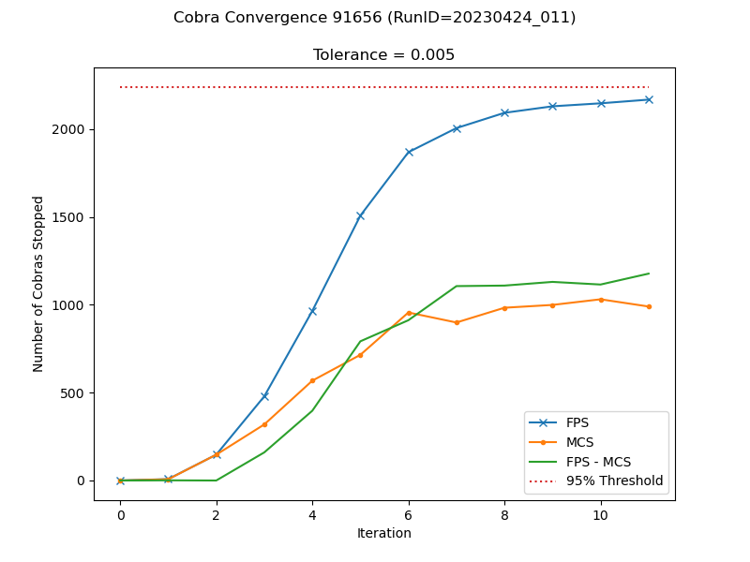
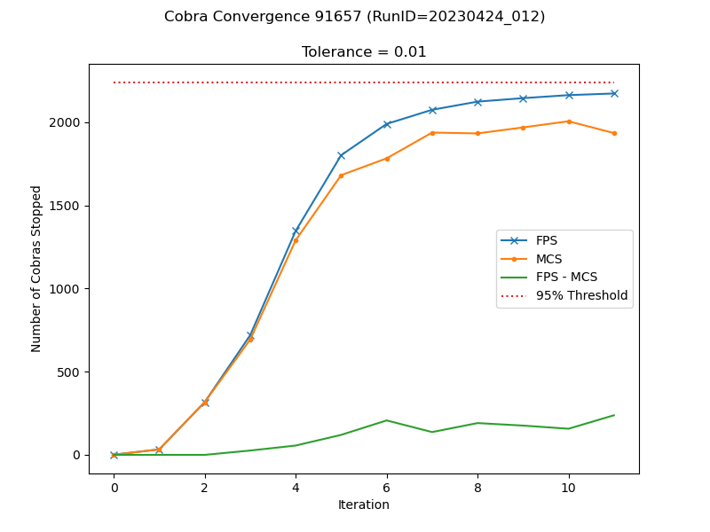
Comparison of different tolerances

Slide 15
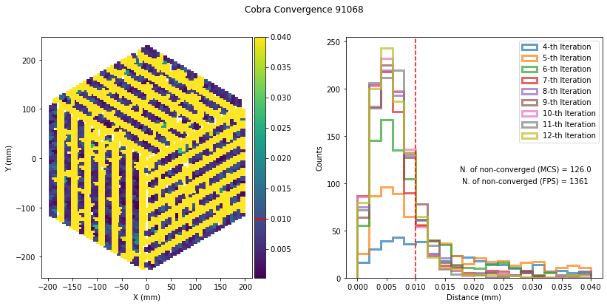
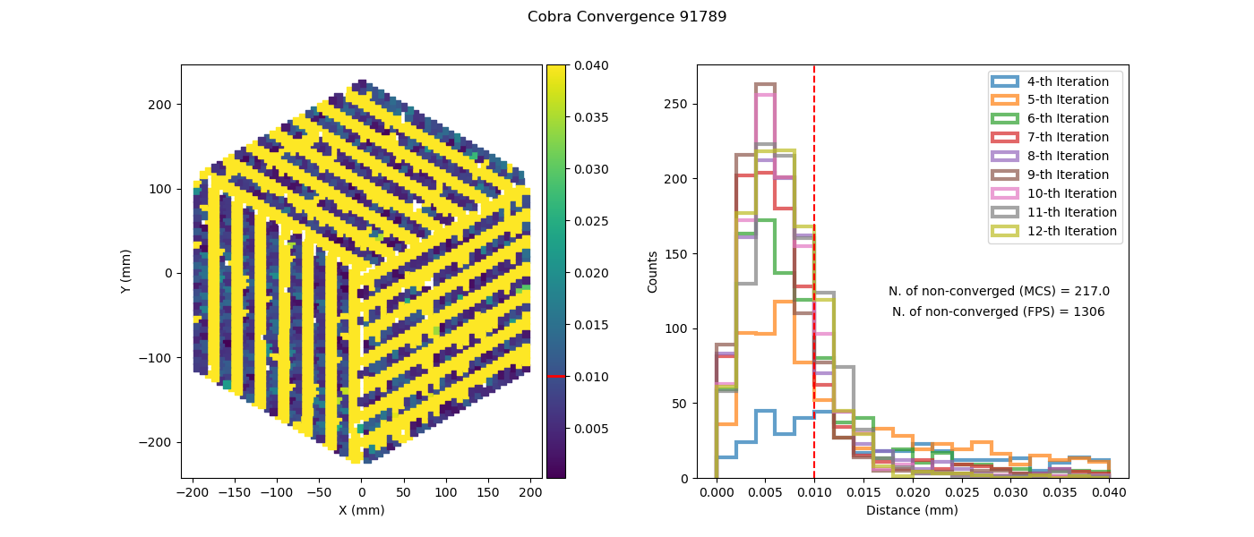
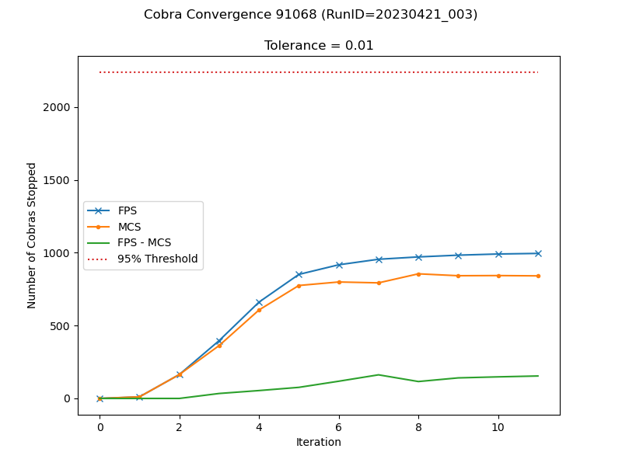
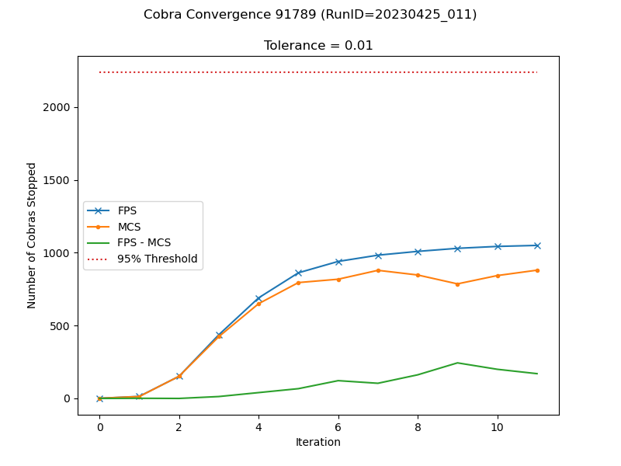
The wrost convergence cases

Slide 16
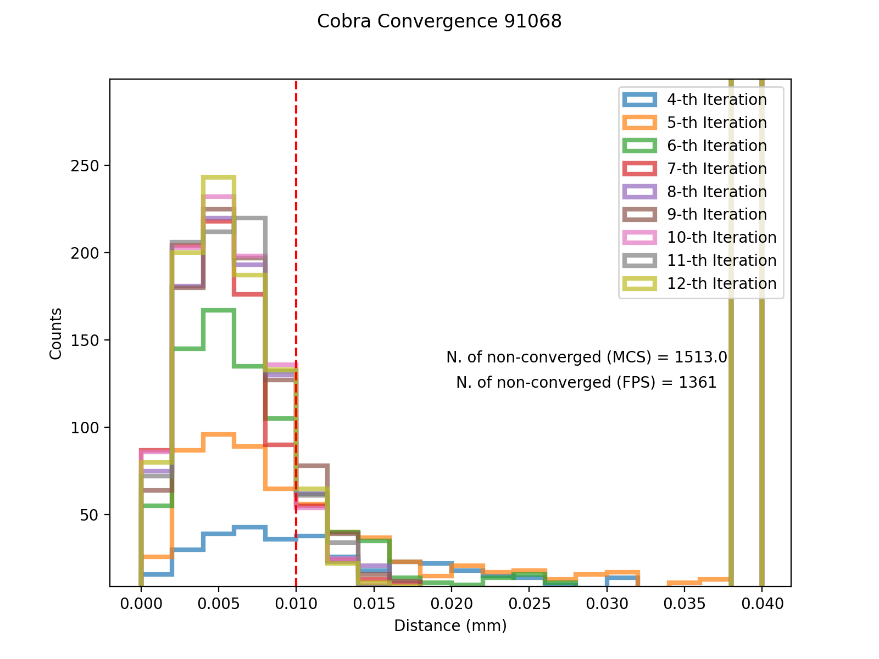
In the case of pfsVisitID=91068, there are many outliers did not show up in the histogram plot.
This field only assign half of fiber. So, unassigned fibers are masked and not moving. However, the FPS did not exclude them.
We need to apply the fix for consistency.

Slide 17
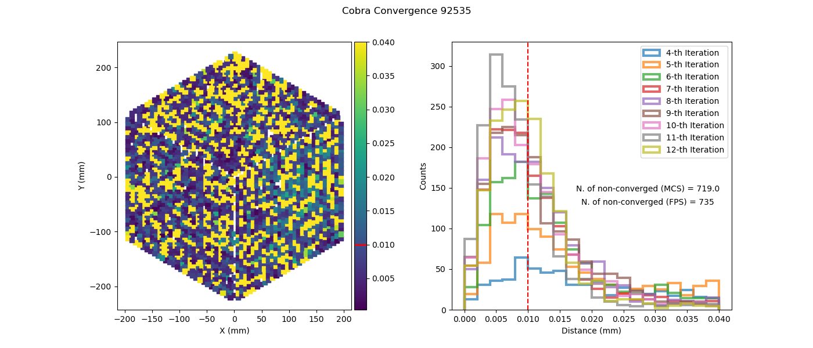
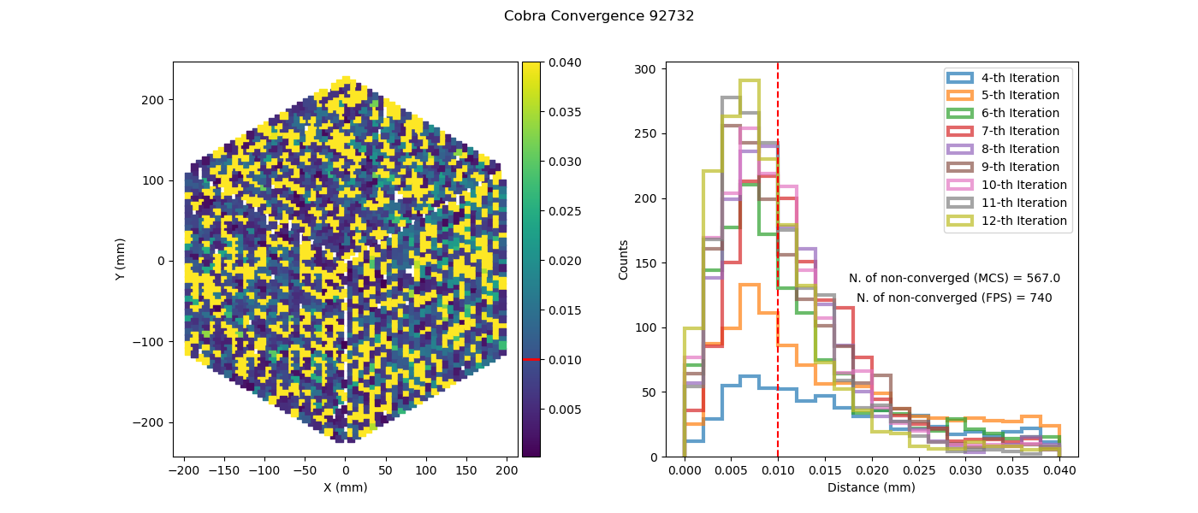
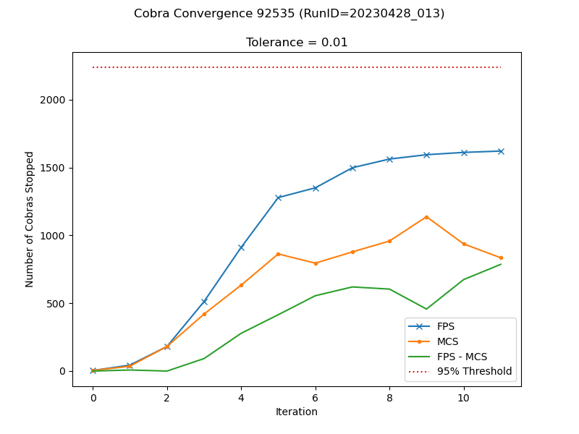
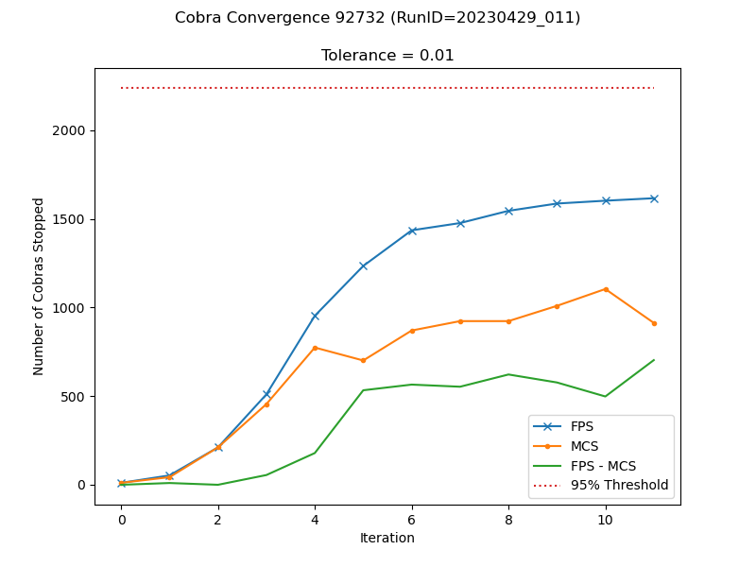
Unassign fibers issue in GA field

Slide 18
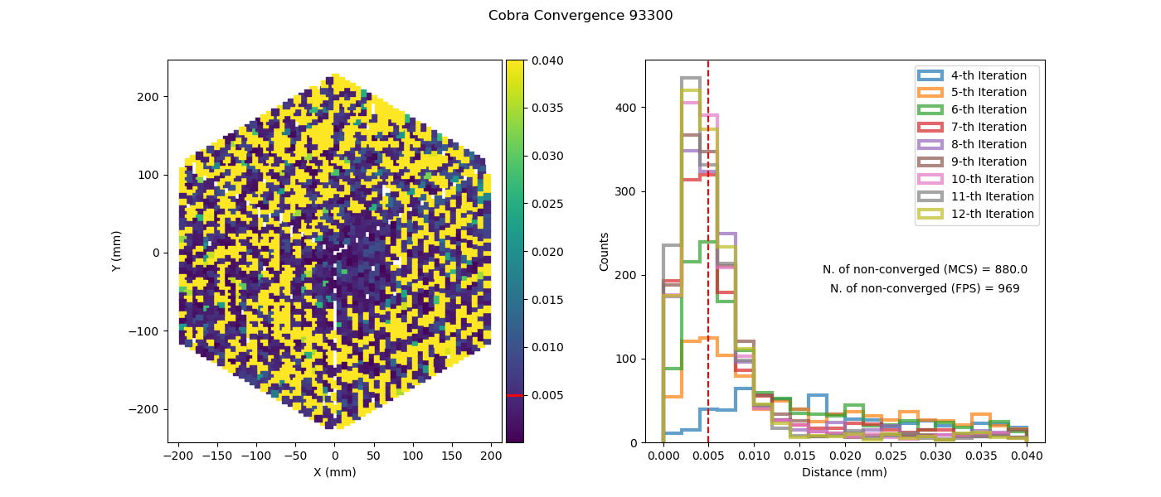
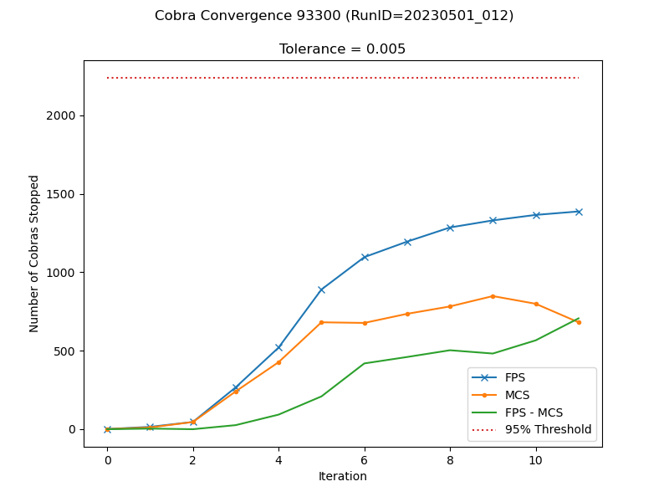
The wrost case of tolerance=0.005(GA field)

Slide 19
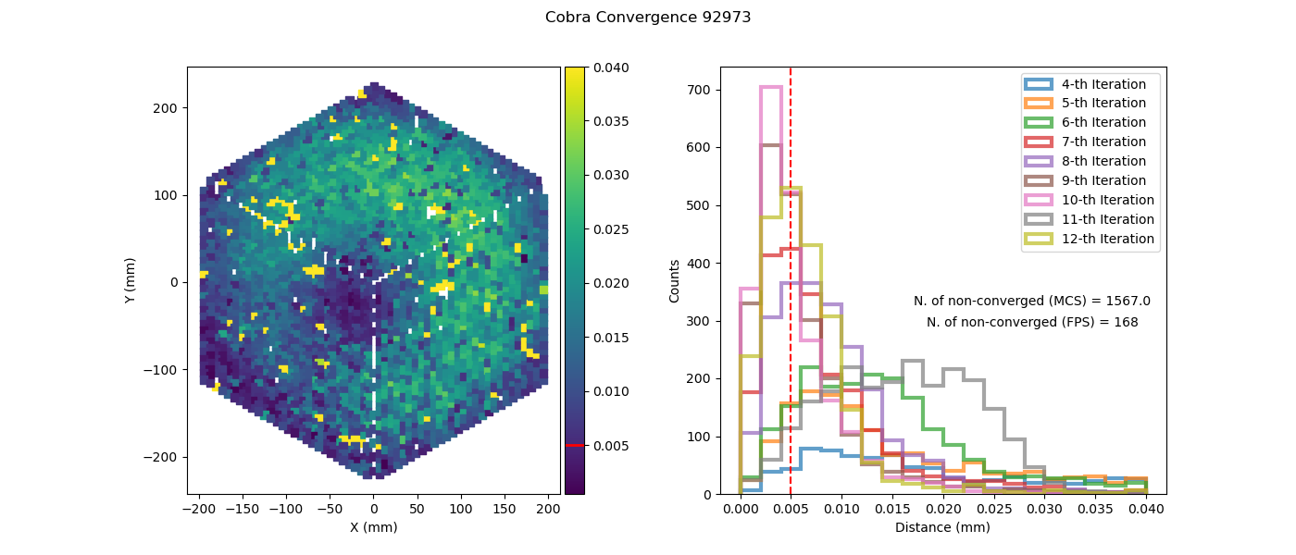
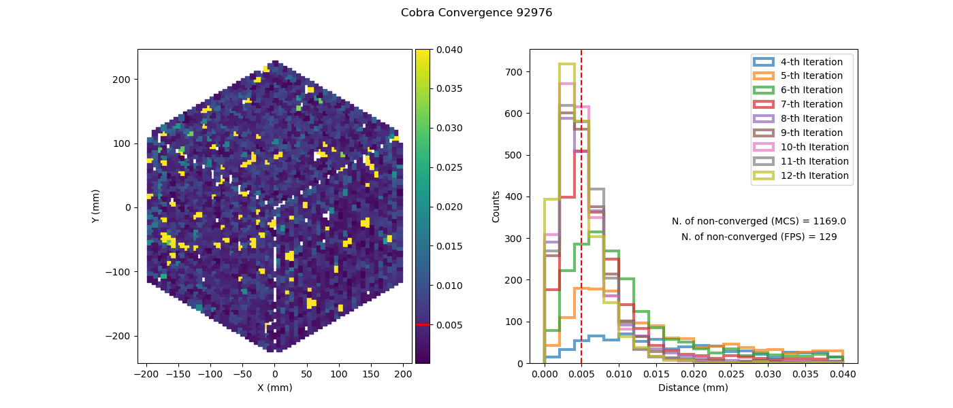
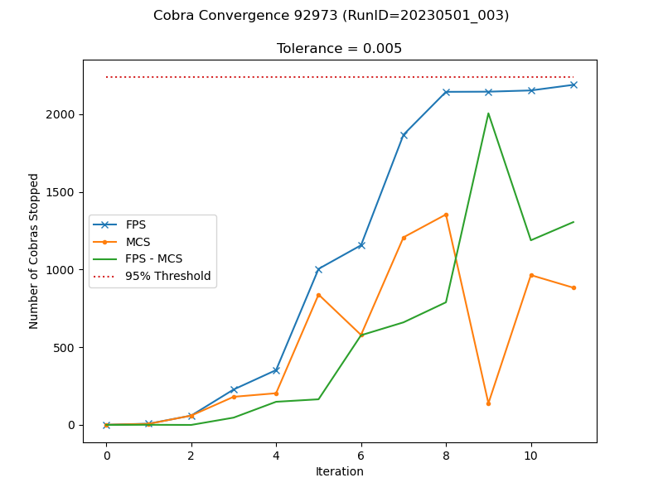
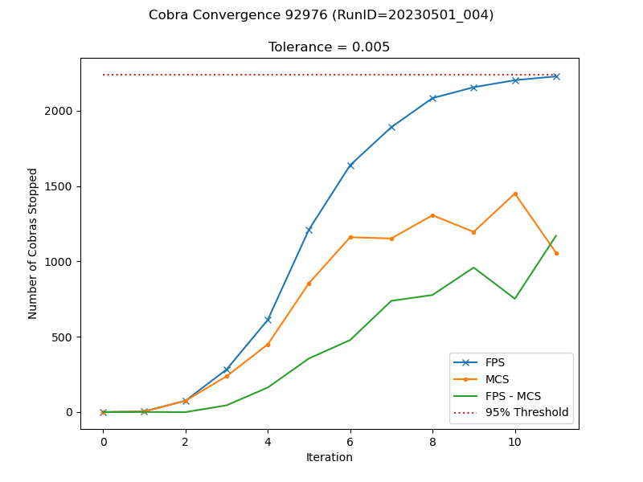
INSTRM-1970 Convergence of visit=92973

Slide 20
Summary
Changing the tolerance from 10 to 5 micron do improve the cobra convergence performance.
Cobra convergences are stable across the Arpil run, except some convergence runs impacted by seeing.
Some worst cases are actually due to book keeping issue. The unassined fiber DID NOT move in FPS operation, but they are included when making the dianostic plots.
We already fix the book keeping issues for usassigned fibers and will be merged to master before next run.

